Slide 1




PDS
CloudFront: Your Content Delivery Superhero!
Computer Vision
https://github.com/siagianp
https://www.youtube.com/@AmelOline/videos
https://github.com/amelcharolinesgn2/Cloud-Infrastructures
https://github.com/amelcharolinesgn2/ClouD-Infrastructure-SISKA-2025
https://github.com/amelcharolinesgn2/CCNA1
https://github.com/amelcharolinesgn2/CCNA2
https://github.com/amelcharolinesgn2/AWS Certificate
Notes:
Lab Session 01: AWS Compute Foundations – EC2, Networking, and Application Deployment Lab Session 02: Identity and Access Control with IAM Lab Session 03: Cloud Storage Solutions – S3, EBS, and EFS Lab Session 04: Database Services – RDS, DynamoDB, and ElastiCache Lab Session 05: Load Balancing and Auto Scaling Lab Session 06: Container Orchestration with ECS, Fargate, and EKS Lab Session 07: Serverless Computing with Lambda Lab Session 08: Monitoring, Logging, and Security Auditing Lab Session 09: Infrastructure as Code – CloudFormation, CDK, and Terraform Lab Session 10: CI/CD Pipelines – App Runner, CodePipeline, GitHub Actions, and CodeDeploy Lab Session 11: AI/ML Services – Rekognition, Comprehend, Translate, and SageMaker Lab Session 12: Hybrid Cloud Networking – VPC Peering, Transit Gateway, VPN, and Direct Connect Lab Session 13: Security and Compliance – AWS Config, GuardDuty, Security Hub, and KMS Lab Session 14: Disaster Recovery and Business Continuity – AWS Backup, Multi-Region, and Failover Lab Session 15: Migration and Modernization – DataSync, DMS, MGN, Containers, and Serverless
Lab Session 16: Cost Management and Optimization – Cost Explorer, Trusted Advisor, Budgets, and Well-Architected
https://www.youtube.com/watch?v=SOTamWNgDKc&t=19604s

Slide 2
CloudFront: Your Content Delivery Superhero!
Accelerating Content Delivery on AWS (CDN Strategies, Security, and Scalability)

Slide 3

Introduction to CDN & CloudFront
What is a CDN?
A Content Delivery Network (CDN) is a globally distributed network of servers that delivers web content (images, videos, scripts) to users based on their geographic location.
What is Amazon CloudFront?
AWS’s CDN service that integrates with other AWS services (S3, EC2, Lambda) to accelerate content delivery with low latency and high transfer speeds.

Slide 4
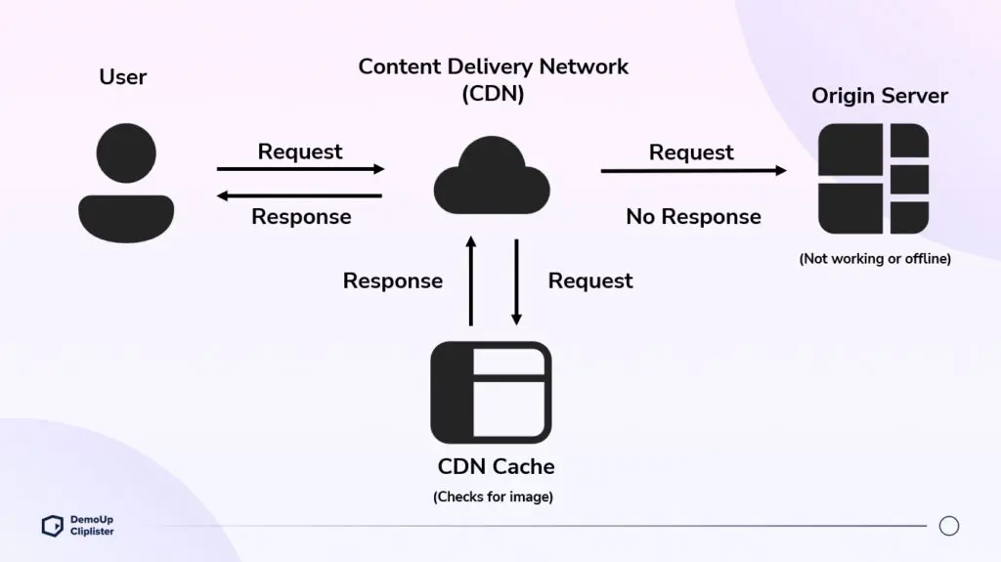

Slide 5
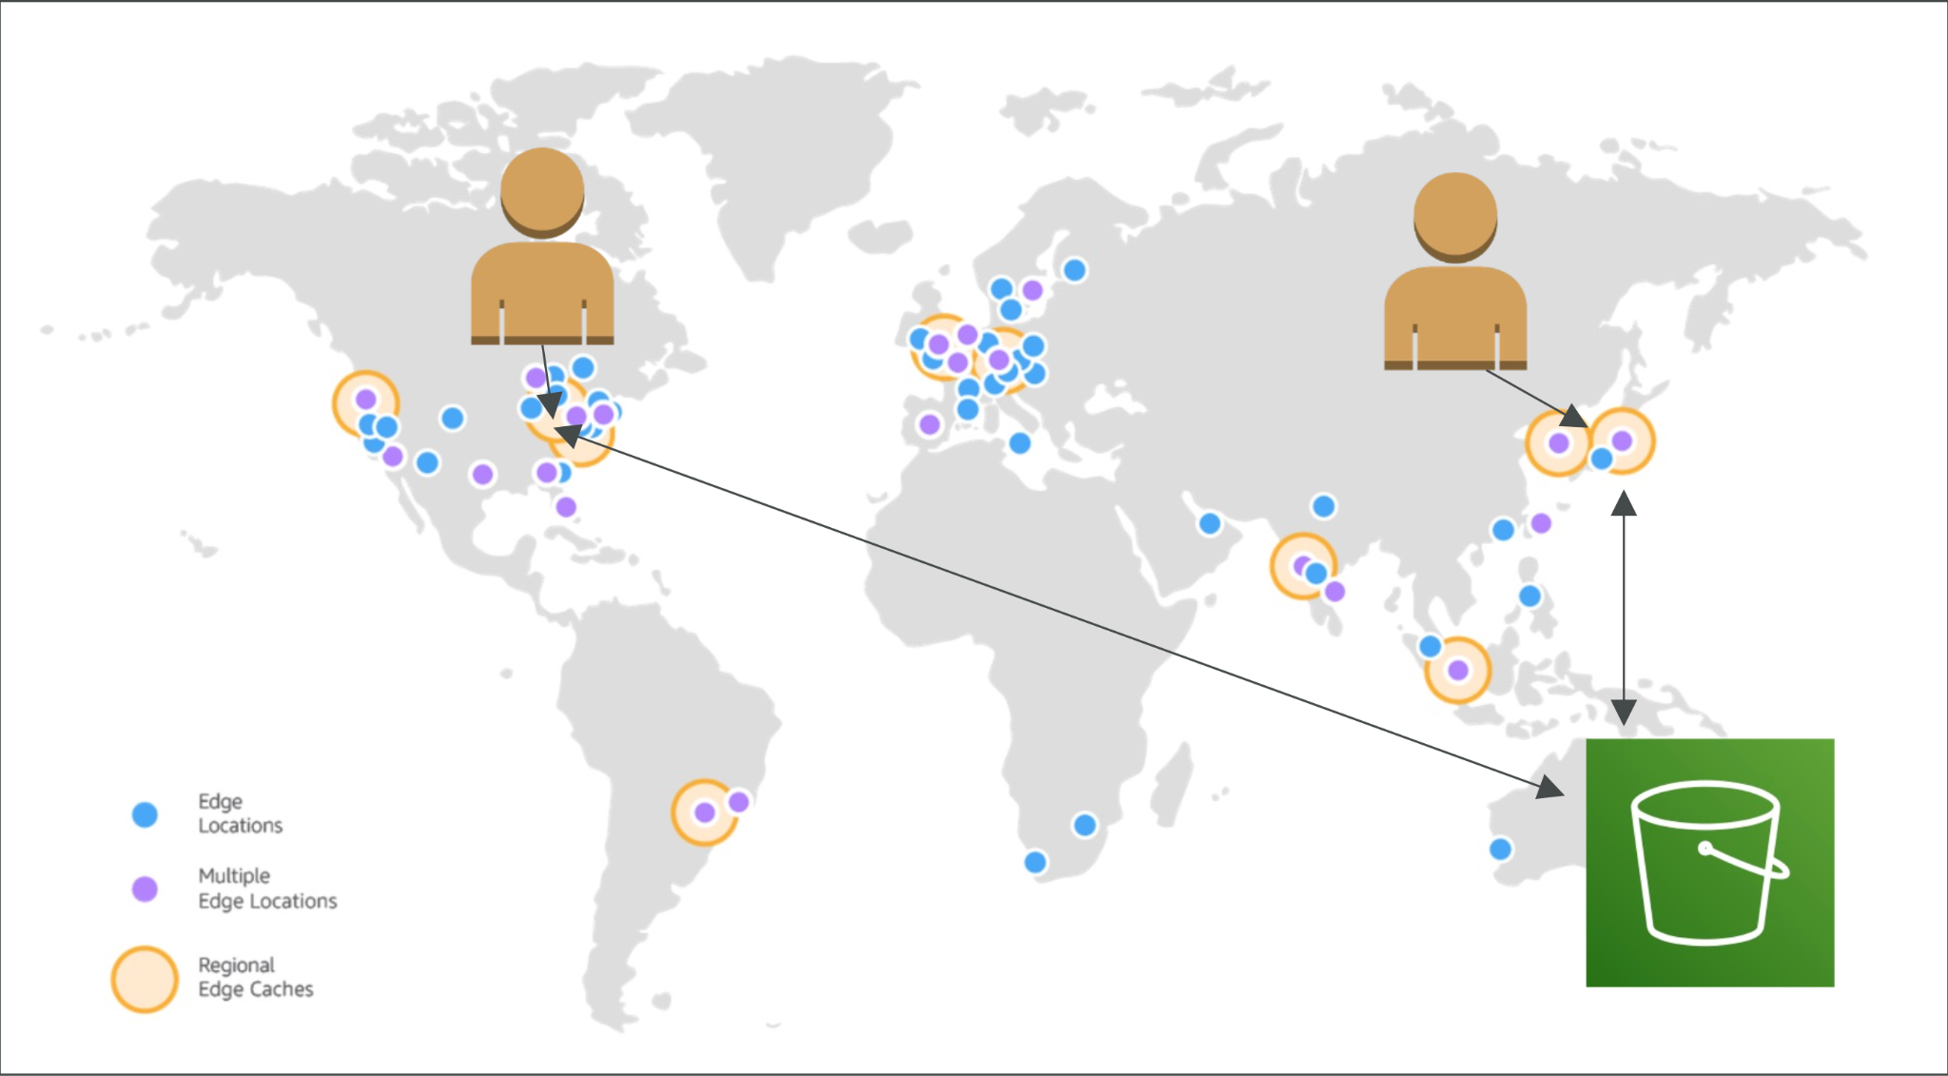

Slide 6
Key Features of CloudFront
Global Edge Locations: 400+ edge locations worldwide.
Caching: Stores content closer to users for faster delivery.
Security: Integration with AWS Shield (DDoS protection), SSL/TLS encryption.
Dynamic Content: Supports both static and dynamic content.
Lambda@Edge: Run serverless code at edge locations.

Slide 7
CloudFront Use Cases
Accelerate Static Websites: Hosted on S3.
Live/On-Demand Video Streaming: Integrates with AWS Media Services.
APIs and Dynamic Content: Caching API responses.
Security: Block malicious traffic with AWS WAF.

Slide 8
Security with CloudFront
SSL/TLS: Encrypts data in transit.
AWS WAF: Block SQL injection, XSS, etc.
Signed URLs/Cookies: Restrict access to private content.
DDoS Protection: Via AWS Shield Standard/Advanced.

Slide 9
Pricing Model
Data Transfer Out: Cost per GB based on region.
HTTP/HTTPS Requests: Cost per 10,000 requests.
Lambda@Edge: Cost based on compute time and requests.
Free Tier: 1 TB/month data transfer + 10 million HTTP requests.

Slide 10
Best Practices
Use Cache-Control Headers to define TTL (Time to Live).
Enable Compression (gzip, Brotli) for faster transfers.
Monitor with CloudWatch Metrics.
Use Origin Shield to reduce origin load.

Slide 11
Setting Up CloudFront
Steps to create a CloudFront distribution.
Configuring origin, behaviors, and caching settings.
Deploying and monitoring CloudFront with AWS tools.

Slide 12
Summary
Amazon CloudFront is a powerful CDN solution.
Enhances performance, security, and scalability.
Seamlessly integrates with AWS services for a robust cloud architecture.

Slide 13
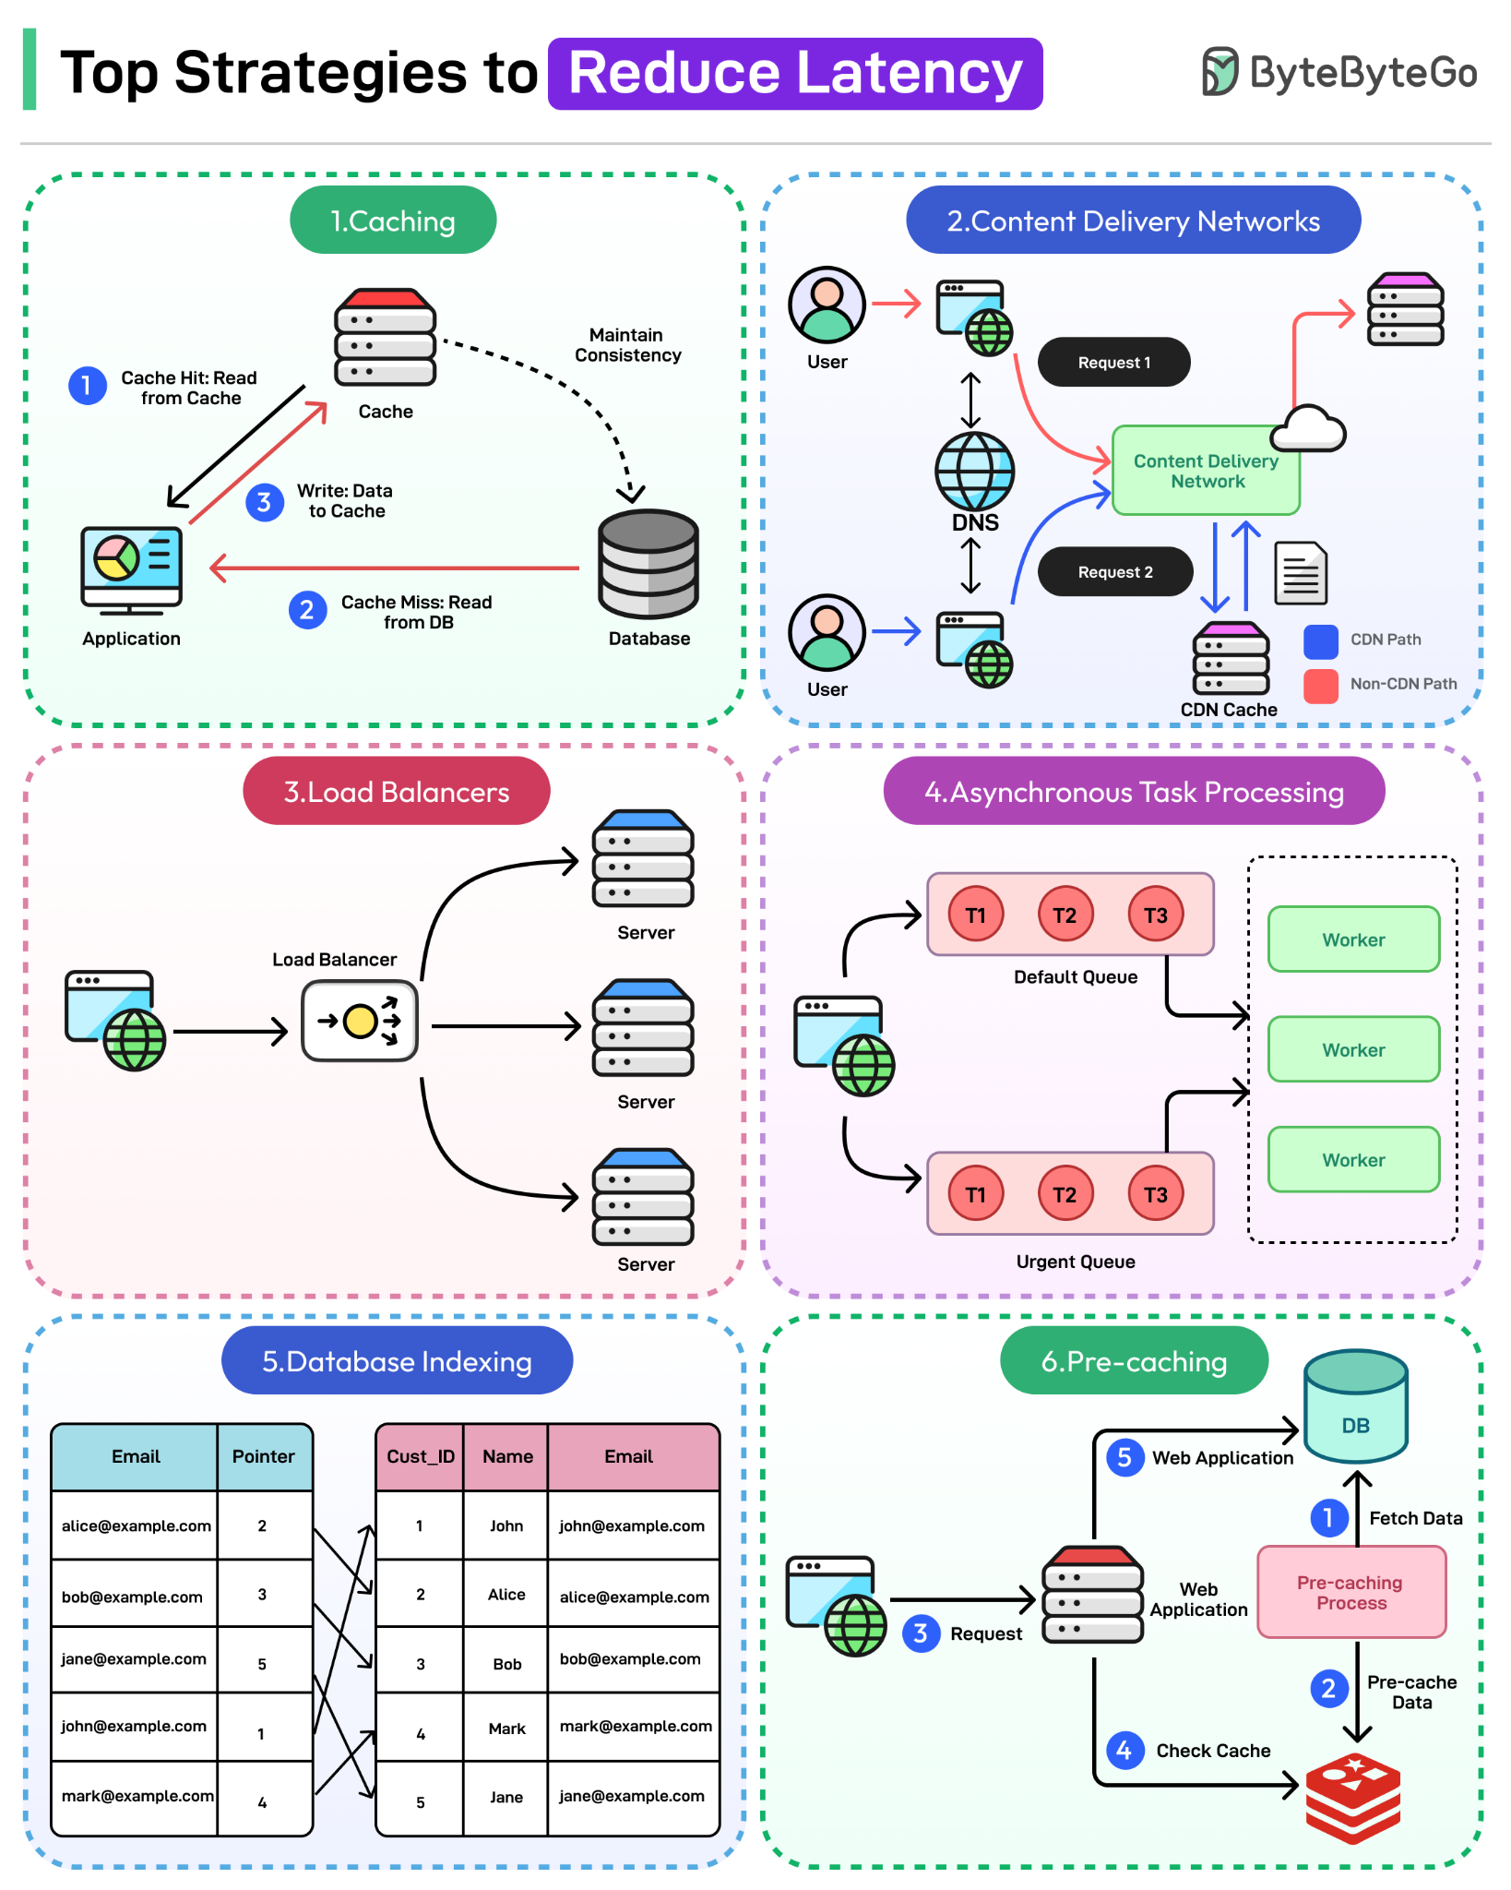

Slide 14
THANK YOU
Amel charoline
Amel Online & Irene magdalena
https://github.com/siagianp
https://www.youtube.com/@AmelOline/videos
https://github.com/amelcharolinesgn2/Cloud-Infrastructures
https://github.com/amelcharolinesgn2/ClouD-Infrastructure-SISKA-2025
https://github.com/amelcharolinesgn2/CCNA1
https://github.com/amelcharolinesgn2/CCNA2
https://github.com/amelcharolinesgn2/AWS Certificate

